Slide 1











Event Management Service Coordination System
Project 5 – Event Management Company
Scala
Play Framework
Akka
Kafka
Docker
Based on microservice architecture with Kafka-driven notifications
SANKET DHOLE

Slide 2














Problem Statement
Current Challenges
Event Management Company
Manual Coordination
No Central View
Handles weddings, corporate events, and private parties.
Calls/WhatsApp leading to miscommunication
Tasks and team status visibility
Service Teams:
No Automated Reminders
No Real-time Alerts
Catering
Missed deadlines
Delays or issues
Decorations
Entertainment
Logistics
Need for a System
Centrally manage events, tasks, teams
Automate notifications, reminders, alerts

Slide 3







System Requirements
Event Setup
Task Assignment
Create event with type, date, guest count, name, etc.
Assign tasks to Catering, Decorations, Entertainment, Logistics
Store event details in Event model
Store task details: taskName, dueDate, teamId, status, specialRequests
Notifications & Reminders
Technical Requirements
Notify teams when: event created, task assigned, task updated, issue reported
Backend using Play Framework with REST APIs
Akka-based microservice for notifications
Send reminders: one day before event, few hours before, event-day alert
Kafka for reliable queuing
Docker for deployment
3/13

Slide 4
















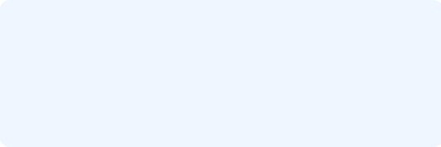
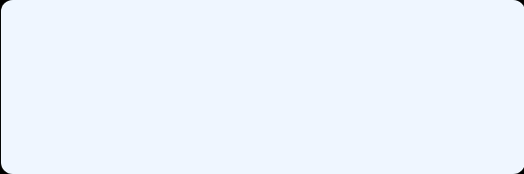










Proposed Solution & Approach
Play Framework
Kafka Integration
REST APIs for event management
Reliable queuing for notifications
EventController
TaskController
Topic: event-management
TeamController
IssueController
EVENT_CREATED
TASK_ASSIGNED
TASK_UPDATED
ISSUE_REPORTED
DAO layer for persistence
EventKafkaProducer service
Akka Notification Service
Deployment
Microservice for handling notifications
Containerized components
Components:
EventKafkaConsumerApp
Play App
Kafka
Akka
EventCoordinatorActor
AlertService
TaskService
Docker Compose for orchestration

Slide 5





















Domain Model – Events, Tasks & Teams
Task
Event
id: Int
Team
id: Int
eventId: Int
id: Int
name: String
teamId: Int
name: String
eventType: String
taskName: String
teamType: String
eventDate: Date
dueDate: Date
phoneNo: String
guestCount: Int
status: String
One-to-many with Task
One-to-many with Task
Belongs-to Team
Issue
id: Int
eventId: Int
taskId: Int
description: String
reportedAt: Date
One-to-many with Event

Slide 6








Overall Architecture
Play Framework App
Event-management
• EventController
Event Manager (User)
• TaskController
• TeamController
• IssueController
• NotificationController
Akka Notification Service
Kafka Broker
Topic: event-management
Service Teams
• EventKafkaConsumerApp
• Receive emails
• EventCoordinatorActor
• Notifications
• AlertServiceActor
• Dashboard access
• TaskServiceActor
• IssueServiceActor
• ReminderServiceActor

Slide 7























Event & Notification Flow
Event Manager
Interacts with system via API calls
Create Event
Assign Tasks
Progress Updates
Report Issues
EventController
TaskController
TaskController
IssueController
Play Framework
Save Event
Create Task
Update Status
Save Issue
REST API
EVENT_CREATED
TASK_ASSIGNED
TASK_UPDATED
ISSUE_REPORTED
Akka Notification Microservice
Email
Alerts
API CallKafka Message

Slide 8























Notification Microservice (Akka)
Kafka Consumption
Event Routing
Notification Handling
EventKafkaConsumerApp
EventNotification case class
ServiceActors build email body
akka.kafka.ConsumerSettings
EventCoordinatorActor.ProcessNotification
Uses EmailHelper.sendEmail()
Subscribes to "event-management"
Pattern matches on evt.event
Email formats: Task Assigned, Status Updated, Issue Reported, Event Alert
Streams using Akka Streams
Dispatches to appropriate actors
Message Flow
AlertServiceActor
Kafka Broker
EventKafkaConsumerApp
EventCoordinatorActor
TaskServiceActor
IssueServiceActor
ReminderServiceActor
Page 8/13

Slide 9







Technology Features Implemented
Scala
Play Framework
Case classes for models: Event, Task, Team, Issue, EventNotification
REST controllers: EventController, TaskController, TeamController, IssueController, AuthController
Extensive use of Options (Option[Int], Option[String]) for nullable fields
Routing and dependency injection using @Inject, @Singleton
Futures and async operations in Play controllers
JSON: Request parsing, validation, and DAO layer for DB CRUD
Type-safe JSON mapping via Play JSON and Spray JSON
Akka
Kafka
Akka Typed Actors: EventCoordinatorActor, AlertServiceActor, TaskServiceActor, IssueServiceActor, ReminderServiceActor
Producer (EventKafkaProducer in Play app): Uses KafkaProducer and ProducerRecord
Message-based communication: Command pattern (Command traits & case classes)
Consumer (EventKafkaConsumerApp): Uses ConsumerSettings, Subscriptions, Consumer.plainSource()
Akka Streams integration with Kafka for reactive consumption
Topic: event-management
Provides loose coupling between core system and notification microservice
9 / 13

Slide 10



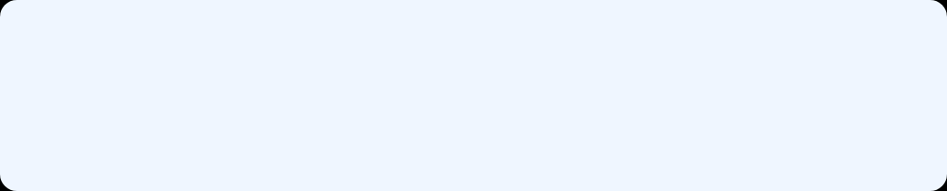






Deployment Plan
Containerization
Local Setup
Play App
Docker Compose Services
Event-management packaged with Dockerfile
play-app
Event-management REST API
Akka Service
Event-kafka-consumer-main with Dockerfile
kafka-broker
Kafka + Zookeeper
Kafka Broker
Kafka + Zookeeper via Docker images
notification-service
Akka/Kafka consumer
Environment Variables
Kafka bootstrap.servers configuration

Slide 11












Screenshots – Event Management
POST /events
Create Event API
POST /tasks
Assign Task API
Request Body (JSON)
Response
Request Body (JSON)
Response
{
{
{
{
"name"
:
"John's Wedding"
,
"id"
:
123
,
"eventId"
:
123
,
"id"
:
789
,
"eventType"
:
"wedding"
,
"name"
:
"John's Wedding"
,
"teamId"
:
456
,
"eventId"
:
123
,
"eventDate"
:
"2023-12-25"
,
"eventType"
:
"wedding"
,
"taskName"
:
"Catering for wedding"
"teamId"
:
456
,
"guestCount"
:
150
"eventDate"
:
"2023-12-25"
,
,
"taskName"
:
"Catering for wedding"
}
"guestCount"
:
150
"dueDate"
:
"2023-12-20"
,
}
}
"status"
:
"PENDING"
}
PUT /tasks/{id}/status
Update Task Status API
GET /tasks/123
Get Tasks API
Request Body (JSON)
Response
Response (JSON Array)
{
{
[
"status"
:
"IN_PROGRESS"
"id"
:
789
,
{
}
"eventId"
:
123
,
"id"
:
789
,
"teamId"
:
456
,
"eventId"
:
123
,
"taskName"
:
"Catering for wedding"
"teamId"
:
456
,
,
"taskName"
:
"Catering for wedding"
,
"status"
:
"IN_PROGRESS"
"status"
:
"IN_PROGRESS"
}
}
]

Slide 12
















Screenshots – Notifications & Kafka
Kafka Console Consumer
Akka Consumer Logs
> kafka-console-consumer.sh --bootstrap-server localhost:9092 --topic event-management
[INFO] Consumed message TASK_ASSIGNED
[DEBUG] Dispatching to TaskServiceActor
Consumed message {'event':'TASK_ASSIGNED','eventId':'123'}
[INFO] Consumed message ISSUE_REPORTED
Consumed message {'event':'ISSUE_REPORTED','eventId':'123'}
[DEBUG] Dispatching to IssueServiceActor
Consumed message {'event':'REMINDER','eventId':'123'}
[INFO] Consumed message REMINDER
[DEBUG] Dispatching to ReminderServiceActor
Sample Email Notification
System Integration Flow
From: notifications@eventmanager.com
2023-05-15
To: catering-team@eventmanager.com
Event Manager
TASK ASSIGNED – Catering
Play API
Event: Corporate Event
Kafka
Task: Catering for 50 guests
Email
Akka
Deadline: 2023-05-20
Status: PENDING

Slide 13











Conclusion & Future Scope
What We Achieved
Future Enhancements
Centralized Management
Web UI Dashboard
Event, task, team, and issue management using Play Framework
Event Manager & Team dashboards for real-time visibility
Role-based Access Control
Reliable Notifications
Admin, Event Manager, and Team role permissions
Asynchronous notifications using Kafka topic and Akka microservice
Communication Integrations
SMS & WhatsApp API integrations
Automated Workflows
Task assignment, progress updates, issue alerts, and event-day alerts
Containerized Deployment
Docker packaging for consistent deployments
Thank you for your attention!
contact@eventmanagement.com

